Slide 1


AI-Powered Border Surveillance System
Information and Communication Technology
SAL INSTITUTE OF TECHNOLOGY AND ENGINEERING RESEARCH
Prepared by
Name – Jainil Gupta
Enrollment No - 220670132018
Guided By – prof. Chintan Rana

Slide 2
Table of Content
Abstract
Project Overview & Objectives
Software Requirements Specification (Find attachment for reference)
Company Profile
Tools & Technologies Used
Key Functionalities/Features
Progress Overview(Current Status of the Project, Completed Phases ,Ongoing Tasks/Modules)
Implementation screen shots(Code Blocks)
Results & Outcomes
Working Demo
Conclusion & Future Scope
References

Slide 3



Border Defence and Surveillance System
with Real-Time Anomaly Detection
Prepared by Binit Patel
Enrollment No: 230143107014
Guided By: Prof. Shreyas Patel
Industry Mentor Name: Adarsh Gupta
Industry Name: GTU Microsoft Elevate Program 2026
Department of Computer Engineering Government Engineering College, Bharuch Affiliated to Gujarat Technological University, Ahmedabad Microsoft Elevate Internship | January – April 2026

Slide 4
Table of Contents
01
Abstract
08
Dataset & Methodology / Pipeline
02
About Internship – Microsoft Elevate
09
Key Features
03
Learning Modules (12-Week Plan)
10
Implementation & Code
04
Problem Statement
11
Results & Model Metrics
05
Project Overview & Objectives
12
Testing & Validation
06
System Architecture
13
Conclusion & Future Scope
07
Technology Stack
14
References
Binit Patel| 230143107014 | Microsoft Elevate Internship 2026
2

Slide 5
Abstract
This report documents a 12-week Microsoft Elevate Internship (Jan – Apr 2026) conducted through the Microsoft Elevate – GTU Program, covering Data Analytics, ML, Deep Learning, Power BI, Generative AI, and Azure Cloud Computing.
Capstone Project Highlights
AI-Powered Border Surveillance System (ABSS) with Real-Time Anomaly Detection
Custom YOLOv8n model trained on DOTA + xView + VisDrone datasets — mAP50 = 0.478 (124% improvement over baseline)
7 threat classes: person, vehicle, crowd, military_vehicle, aircraft, ship, suspicious_object
Zone-based intrusion detection + temporal pattern analysis + ensemble anomaly detection (IF + RF)
Streamlit dashboard, Azure Blob Storage + Cosmos DB, 285 automated pytest tests, CI/CD via GitHub Actions
AZ-900 Certification achieved with score 820/1000
Keywords: YOLOv8 · Isolation Forest · Border Surveillance · Azure · Streamlit · Zone Detection · GTU 2026
Binit Patel| 230143107014 | Microsoft Elevate Internship 2026
3

Slide 6
About Internship – Microsoft Elevate Program
Program
Microsoft Elevate – GTU Internship 2026
Administered By
Edunet Foundation & FICE Education
Duration
12 Weeks | January 01 – April 15, 2026
Mode
Virtual (Live Sessions + Self-Paced Labs)
Platform
Microsoft Teams, Microsoft Learn, Azure Labs
GTU Subject Code
3180701 – 8th Semester Internship
External Guide
Mr. Adarsh Gupta, Program Coordinator
Internal Guide
Prof. Shreyas Patel, Asst. Prof., CE Dept.
Certification
Microsoft Azure Fundamentals (AZ-900) – 820/1000
Binit Patel| 230143107014 | Microsoft Elevate Internship 2026
4

Slide 7
Learning Modules – 12-Week Curriculum
Wk 1–2
Data Analytics & EDA
Wk 3–4
Power BI & Business Intelligence
Pandas, NumPy, Matplotlib, Seaborn, statistical analysis
DAX, interactive dashboards, data modelling
Wk 5–6
Machine Learning
Wk 7–8
Deep Learning & Computer Vision
Supervised & Unsupervised ML, Scikit-learn, evaluation metrics
ANN, CNN, TensorFlow/Keras, Transfer Learning
Wk 9
Generative AI & Prompt Engg.
Wk 10–12
Microsoft Azure Cloud
GitHub Copilot, prompt design, LLM fundamentals
Blob Storage, Cosmos DB, DevOps, CI/CD, AZ-900
Binit Patel| 230143107014 | Microsoft Elevate Internship 2026
5

Slide 8
Problem Statement
Border surveillance generates vast visual data that is impossible to monitor through human observation alone.
Large-Scale Monitoring Gap
Insufficient staff to cover extensive border areas with multiple simultaneous camera feeds
Delayed Threat Detection
Manual analysis introduces 5–15 minute latency between intrusion event and operator response
High False Alarm Rates
Animals, weather, and environmental noise trigger unnecessary alerts, causing operator fatigue
Resource Constraints
Deploying human personnel in remote and harsh terrain is logistically expensive
Data Silos
Camera feeds, motion sensors, and patrol logs exist as disconnected data streams with no integration
Binit Patel| 230143107014 | Microsoft Elevate Internship 2026
6

Slide 9
Project Overview
AI-Powered Border Surveillance System (ABSS) with Real-Time Anomaly Detection
End-to-end intelligent video surveillance pipeline developed as capstone for Microsoft Elevate Internship
Processes surveillance video footage using OpenCV and custom YOLOv8n object detection
Detects 7 threat classes: person, vehicle, crowd, military_vehicle, aircraft, ship, suspicious_object
Dual-stage anomaly scoring: Unsupervised (Isolation Forest) + Supervised (Random Forest) ensemble
Spatial zone intrusion detection across 3 configurable threat zones using ray-casting algorithm
Multi-frame temporal pattern analysis via IoU-based object tracking sliding window
Generates prioritised alerts (CRITICAL / HIGH / MEDIUM / LOW) with Azure cloud integration
GitHub: github.com/binitp2 | AZ-900 Certification: 820/1000 | 285 Automated Tests Passed
Binit Patel| 230143107014 | Microsoft Elevate Internship 2026
7

Slide 10
Project Objectives
1
Train custom YOLOv8n model on DOTA + xView + VisDrone to detect 7 threat classes with mAP50 > 40%
2
Implement unsupervised anomaly detection using Isolation Forest on a 10-dimensional feature vector
3
Develop supervised anomaly classification (Random Forest) for CRITICAL / HIGH / MEDIUM / LOW priority levels
4
Build spatial zone-based intrusion detection for 3 configurable surveillance zones (ray-casting algorithm)
5
Implement multi-frame temporal pattern analysis detecting 5 behavioural anomaly types via IoU tracking
6
Integrate Azure Blob Storage (alert frame storage) and Cosmos DB (alert metadata persistence)
7
Deploy real-time Streamlit operational dashboard with geographic visualization and email alerting
8
Validate all modules through ≥200 automated pytest test cases with GitHub Actions CI/CD
Binit Patel| 230143107014 | Microsoft Elevate Internship 2026
8

Slide 11
System Architecture – 6-Stage AI Pipeline
Stage 1
Stage 2
Stage 3
Stage 4
Stage 5
Stage 6
Preprocessing
→
Object Detection
→
Zone Analysis
→
Temporal Analysis
→
Anomaly Detection
→
Alert & Storage
OpenCV reads video frames
Resize to 640×640, frame skip
Optical flow for motion scoring
Custom YOLOv8n inference
7 threat class detection
Bounding box + confidence score
Ray-casting point-in-polygon
3 zones: Border / Buffer / Obs.
Intrusion flag per detection
IoU-based object tracker
Sliding window (N frames)
5 behavioural anomaly types
Isolation Forest (unsupervised)
Random Forest (supervised)
Priority: CRITICAL→LOW
Prioritised alert merge
Azure Blob + Cosmos DB
Email / Streamlit dashboard
Azure Integration Layer
Azure Blob Storage (alert-frames container) → Azure Cosmos DB (SurveillanceDB / Alerts) → Streamlit Dashboard (real-time refresh)
Fail-safe degradation: system runs without Azure, without Random Forest, and without zone/temporal analyzers
Binit Patel| 230143107014 | Microsoft Elevate Internship 2026
9

Slide 12
Technology Stack
Category | Technology / Library | Details
Object Detection | YOLOv8n (Ultralytics) | Custom-trained, 7 classes, 30 epochs, DOTA+xView+VisDrone
Anomaly Detection | Isolation Forest + Random Forest | Scikit-learn 1.4+, 10-dim feature vector, 200 estimators
Video Processing | OpenCV 4.x | Farneback optical flow, VideoWriter, frame extraction
Dashboard | Streamlit + Plotly | Multi-page layout, st_autorefresh, Scatter Mapbox, donut charts
Cloud Storage | Azure Blob Storage | azure-storage-blob SDK 12.19, alert-frames container
Cloud Database | Azure Cosmos DB (NoSQL) | azure-cosmos SDK, SurveillanceDB, Alerts collection
Email Alerts | SendGrid / Gmail SMTP | HTML email templates, SendGrid API v3
CI/CD | GitHub Actions | YAML pipelines, Ubuntu-latest, Python 3.10.20
Testing | pytest | 285 tests, 6 modules, mock-based isolation
Data Science | Pandas, NumPy | DataFrames, array operations, statistical summaries
Binit Patel| 230143107014 | Microsoft Elevate Internship 2026
10

Slide 13
Dataset & Training Methodology
Training Datasets
DOTA
xView
VisDrone
Aerial imagery dataset
280K annotated objects
15 object categories
Vehicle + infrastructure detection
Satellite imagery dataset
1M+ annotated objects
0.3m resolution
Object detection training
Drone surveillance imagery
Crowd, person, vehicle
Real-world capture scenarios
Urban + rural environments
Detection & Anomaly Pipeline
Frame
Extraction
YOLOv8n
Inference
Feature
Extraction
(10-dim)
Isolation
Forest
(IF)
Random
Forest
(RF)
Ensemble
Priority
Scoring
→
→
→
→
→
Dataset class imbalance was addressed by capping dominant classes and upsampling rare ones
YOLOv8n trained for 30 epochs — mAP50 improved from 0.213 (baseline) to 0.478 (balanced)
Isolation Forest uses 10 features: detection count, confidence scores, optical flow, crowd density, zone flags
Binit Patel| 230143107014 | Microsoft Elevate Internship 2026
11

Slide 14
Key Features
Real-Time Object Detection
Zone-Based Intrusion Detection
Temporal Pattern Analysis
Custom YOLOv8n – 7 threat classes
Bounding box + confidence scoring
DOTA + xView + VisDrone training
3 configurable threat zones
Ray-casting point-in-polygon
Border / Buffer / Observation zones
IoU-based multi-frame tracking
5 behavioural anomaly types
Sliding window across N frames
Ensemble Anomaly Detection
Real-Time Alert System
Streamlit Dashboard
Isolation Forest (unsupervised)
Random Forest (supervised)
10-dim feature vector scoring
CRITICAL / HIGH / MEDIUM / LOW
Email via SendGrid / Gmail SMTP
Azure Cosmos DB persistence
Multi-page operational layout
Geographic threat visualization
Auto-refresh, donut charts
Binit Patel| 230143107014 | Microsoft Elevate Internship 2026
12

Slide 15
Implementation – Code Snippets
YOLOv8 Object Detection
Ensemble Anomaly Detection
from ultralytics import YOLO
model = YOLO('border_v2_balanced.pt')
results = model.predict(
source='frame.jpg', conf=0.25
)
for r in results:
for box in r.boxes:
cls = model.names[int(box.cls[0])]
from sklearn.ensemble import (
IsolationForest, RandomForestClassifier
)
iso = IsolationForest(
contamination=0.1, random_state=42
)
iso_pred = iso.fit_predict(features)
rf = RandomForestClassifier(n_estimators=200)
rf_pred = rf.predict(X_test)
Zone Intrusion Detection (Ray-Casting)
Azure Blob Storage + Cosmos DB
# Ray-casting point-in-polygon
def point_in_zone(x, y, polygon):
inside = False
n = len(polygon)
j = n - 1
for i in range(n):
xi, yi = polygon[i]
xj, yj = polygon[j]
if ((yi>y)!=(yj>y)) and \
(x<(xj-xi)*(y-yi)/(yj-yi)+xi):
inside = not inside
j = i
return inside
from azure.storage.blob import BlobServiceClient
from azure.cosmos import CosmosClient
# Upload alert frame to Blob Storage
blob_svc = BlobServiceClient\
.from_connection_string(conn_str)
client = blob_svc.get_container_client(
"alert-frames"
)
client.upload_blob(frame_bytes)
# Persist alert to Cosmos DB
container.upsert_item(alert_doc)
Binit Patel| 230143107014 | Microsoft Elevate Internship 2026
13

Slide 16
Results & Model Metrics
0.478
+124%
0.457
0.870
mAP50 (Final Model)
Improvement vs Baseline
Recall (from 0.043)
Ship Class mAP50
Class-wise mAP50 Comparison (Baseline vs Balanced Training)
Binit Patel| 230143107014 | Microsoft Elevate Internship 2026
14

Slide 17
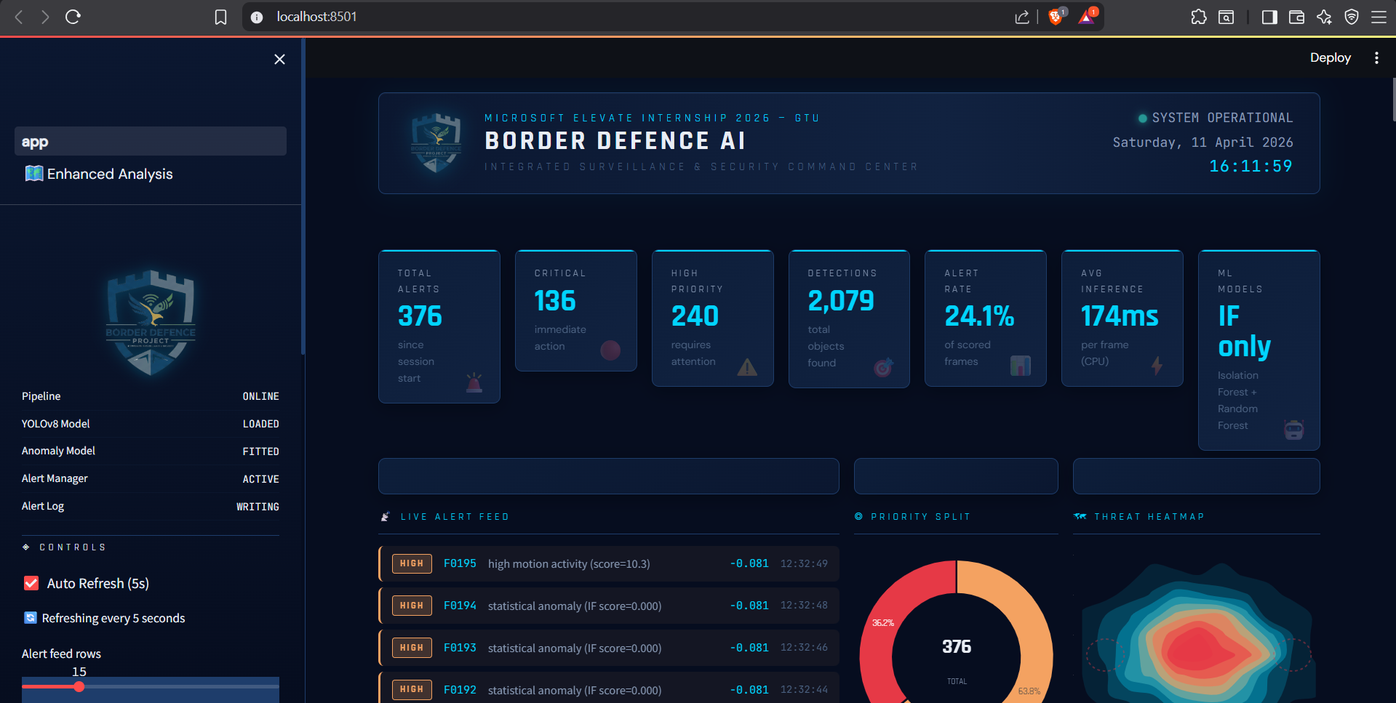
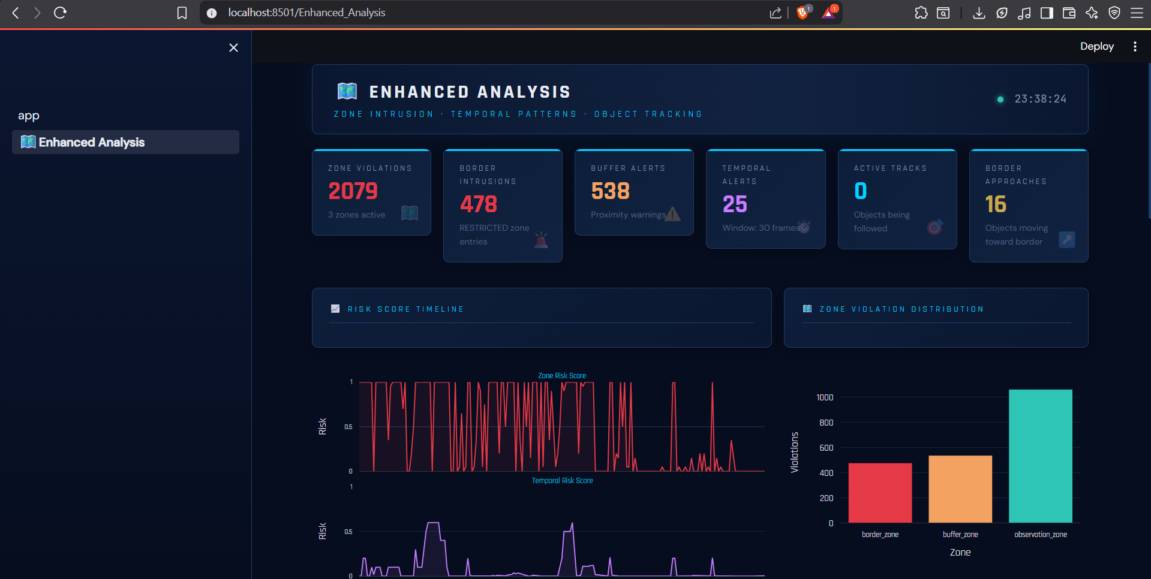
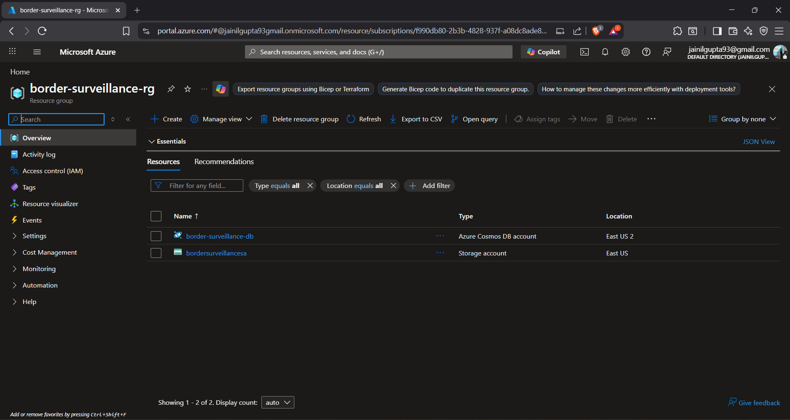
Screenshots – Streamlit Dashboard & System Output
[ Screenshot Area ]
[ Screenshot Area ]
[ Screenshot Area ]
Dashboard – Command Center
Dashboard – Enhanced Analysis
Azure Blob
Real-time alert feed, detection counters
priority breakdown, system status
Geographic threat map, anomaly heatmap
zone intrusion timeline charts
Alert frame upload confirmation
Cosmos DB metadata persistence log
Note: Replace placeholder boxes with actual dashboard screenshots from your project demo for the final viva submission.
Multi-page layout: Command Center | Enhanced Analysis | Configuration
Auto-refresh via st_autorefresh, Scatter Mapbox for geographic visualization, Plotly donut charts
Binit Patel| 230143107014 | Microsoft Elevate Internship 2026
15

Slide 18
Testing & Validation
285
100%
6
CI/CD
Total Automated Tests
Tests Passed (CI/CD)
Modules Tested
GitHub Actions Pipeline
Test Suite Summary by Module
Module | Test Count | Coverage Focus
test_preprocessing.py | 45 tests | Frame extraction, resize, flow
test_detector.py | 52 tests | Detection confidence, NMS, class mapping
test_anomaly_detector.py | 48 tests | IF scoring, RF classifier, priority mapping
test_zone_analyzer.py | 38 tests | Ray-casting, zone config, edge cases
test_temporal_analyzer.py | 42 tests | IoU tracking, pattern detection, window
test_alert_manager.py | 60 tests | Alert merge, Azure upload, email dispatch
All tests use mock-based module isolation (no live Azure or camera required)
GitHub Actions YAML pipeline runs on every git push — Ubuntu-latest, Python 3.10.20
Binit Patel| 230143107014 | Microsoft Elevate Internship 2026
16

Slide 19
Conclusion
What Was Achieved
Designed and deployed a production-grade AI surveillance system integrating Computer Vision, ML, and Cloud Computing
Custom YOLOv8n model achieved mAP50 = 0.478 — a 124% improvement — validating the balanced training strategy
Recall improved nearly 10× (0.043 → 0.457); Ship class detection rose from 0.000 to 0.870 mAP50
Zone-based intrusion detection and 5-type temporal pattern analysis deliver advanced spatial-temporal threat intelligence
285 automated pytest tests with GitHub Actions CI/CD ensure production-quality code reliability
Azure Blob Storage + Cosmos DB provide scalable cloud persistence; Streamlit dashboard enables real-time monitoring
AZ-900 Microsoft Azure Fundamentals certification achieved with score 820/1000
Practically applies all 12 weeks of Microsoft Elevate curriculum in a real national-security scenario
Impact: Automates border threat detection, reduces manual monitoring burden, improves response time, and scales to multi-camera infrastructure via Azure Cloud.
Binit Patel| 230143107014 | Microsoft Elevate Internship 2026
17

Slide 20
Future Scope
GPU Acceleration
Multi-Camera Streaming
Integrate TensorRT / ONNX Runtime for GPU-accelerated YOLOv8 inference to achieve real-time FPS at edge devices
Extend architecture to handle concurrent RTSP/HLS feeds from multiple cameras using async processing
Improved Model
Facial/Plate Recognition
Train YOLOv8m or YOLOv8l on expanded dataset (DOTA v2, VisDrone-DET) for higher mAP50 and smaller objects
Add optional modules for face recognition and license plate detection in high-priority intrusion zones
Edge Deployment
Kubernetes Scaling
Deploy models on NVIDIA Jetson or Raspberry Pi + Coral TPU for on-site low-latency surveillance
Containerize pipeline with Docker Compose and orchestrate with Azure Kubernetes Service for enterprise scaling
Binit Patel| 230143107014 | Microsoft Elevate Internship 2026
18

Slide 21
References
Datasets
DOTA: captain-whu.github.io/DOTA/ — 280K annotated aerial objects
xView: xviewdataset.org/ — 1M+ satellite-annotated objects
VisDrone: github.com/VisDrone — Drone aerial surveillance benchmark
Technologies
YOLOv8 / Ultralytics: docs.ultralytics.com
Microsoft Azure: azure.microsoft.com
Streamlit: streamlit.io | Scikit-learn: scikit-learn.org
Research Papers
Real-world Anomaly Detection in Surveillance Videos – Sultani et al. (CVPR 2018)
YOLOv8: Advanced Object Detection Architecture – Jocher et al. (Ultralytics, 2023)
Enhancing Border Security Through Computer Vision – IEEE Transactions
Isolation Forest – Liu, Ting & Zhou (ICDM 2008)
Program
Microsoft Elevate – GTU Internship Program, Edunet Foundation & FICE Education (2026)
Binit Patel| 230143107014 | Microsoft Elevate Internship 2026
19
Microsoft Learn Platform: learn.microsoft.com
AZ-900 Microsoft Azure Fundamentals – Certification Documentation

Slide 22
Thank You
Questions & Discussion Welcome
Patel Binit Umesh | Enrollment No: 230143107014 Email: binitp2@outlook.com GitHub: https://github.com/binitp2 LinkedIn: https://www.linkedin.com/in/dte-gecbh-com-binitpatel/
Government Engineering College, Bharuch | Microsoft Elevate Internship 2026

